Slide 1

Parsing with llms
Anastasia Brinati – NLP 2023/2024

Slide 2
What’s our CHALLENGE?
Parsing
LLM
Better parsing

Slide 3
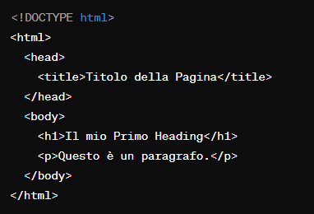
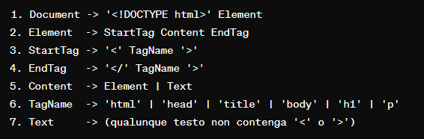
What is Parsing?
Mario
mangia
la mela.
Parsing is the process of checking the constituency of sequences of symbols, whether or not their structure is compliant to a certain formal grammar.

Slide 4
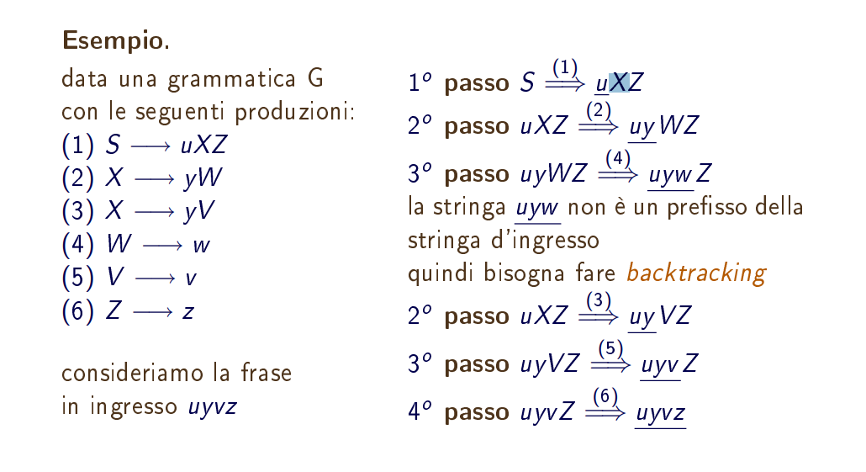
how to parse?
Top-Down:
build the derivation tree from root to leaves;
starting from the ‘higher’ production of the grammar and try to generate the input sequence;
at each step we expand the left-most non-terminal without children;

Slide 5
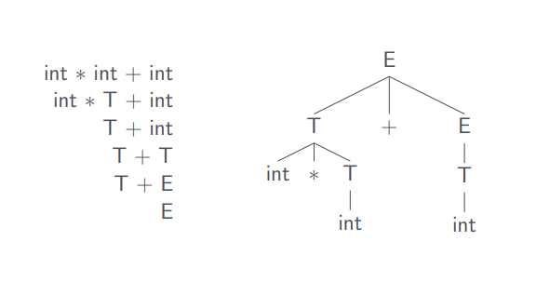
how to parse?
Bottom-Up:
Starting from the input sequence we build backward up to the ‘higher’ production.
E → E + T | T
T → int * T | ( E ) | int

Slide 6
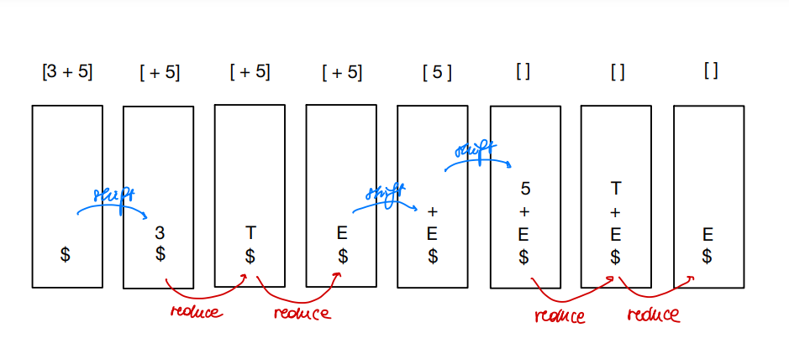
Shift-reduce ParSIng
E → E + T | T
T → int
Buffer :
Stack :

Slide 7


LLM
A Large Language Model (LLM) is a language model that stands out in the field of artificial intelligence for its proficiency in both generating and comprehending human-like language. These are usually trained on a large quantity of data, documents and texts.

Slide 8
How to use llm in shift reduce parsing? pt1
Decision making when Shifting or Reducing:
During the shift operation, an LLM could be used to predict which word should be added to the stack next, looking at the syntactic context.
During the reduce phase, an LLM could help deciding which group of tokens should be reduced together, keeping an eye on the context.
Guiding the choice of non-terminals:
When reducing, an LLM can guide the choice of non-terminal symbols to insert into the stack.
Handling ambiguity:
In situations where the parser faces syntactic ambiguities, an LLM can assign probabilities to the different options and guide the best choice based on the context .

Slide 9
How to use llm in shift reduce parsing? pt2
What to produce when doing a Reduce:
When reducing, an LLM could assist in selecting the best production through probabilities, based on the current semantic context.
Integrating sematic knowledge:
An LLM trained on a large corpus can be used to integrate semantic knowledge while parsing, aiutando a identificare relazioni semantiche e significati più complessi.
Correcting parsing errors:
If the parser happens to be mistaken after the syntactic analysis, an LLM can suggest corrections based on the probabilities of correct token sequences.
Adapting the parser dynamically:
The parser could be adapted during the analysis of certain input sections, allowing to model more precisely linguistic structures based on the context.

Slide 10
Expected benefits
Increasing precision:
LLM can help making more accurate decisions when doing Shift and Reduce, increasing the general precision of the parser.
Handling Ambiguity:
Contribute to solve syntactic ambiguities, by handling the semantic context.
Adapt to Linguistic Contexts:
Integrating an LLM could make the parser adapt to different linguistic contexts, particularly when facing more complex or less conventional syntactic constructs.

Slide 11
Considerations
Availability of Training Data:
It should be noted when using a LM, that it’s efficiency depends heavly on the quality and dimension of the training corpus, and on the capacity of the model to understand the syntactic and semantic contexts.
Interpretability and Explainability:
Internal complexity of LLMs can make it difficult to understand and explain why to apply certain corrections or other suggestions. The lack of interpretability can be a problem when it is required to ccomprehend thoroughly the decision process.
Computational complexity:
Integrating an LLM can increase the complexity of the parsing process: it is fundamental to consider the trade-off between computational efficiency with the precision required, balance the model dimension with the parser quality.

Slide 12
Thank you

